Slide 1

Online Retail Store
Precious Arovo
arovoprecious@gmail.com

Slide 2

Report for revenue and demand performance exploratory analysis on a virtual online retail store

Slide 3

This report presents an overview of the revenue and demand performance exploratory analysis carried out on the dataset of a virtual online retail store, geared toward obtaining effective insights that would equip the CEO and CMO of the business in making empowering and informed business decisions for the business.

Slide 4
Outline
Objective
The Business Background
The Business Scenario - Questions of Interest
Results
Conclusion

Slide 5
Objective
The main objective of the exploratory analysis for which the report is meant is to obtain effective insights that would be valuable to the CEO and CMO of the business. Thus, at the end of this analysis, I should be providing visually and non-visually supported answers to the questions that would be provided in the QUESTIONS OF INTEREST section of this report.
These sets of questions are considered to be likely questions of interest to be asked by the CEO and CMO of an online retail store in a typical business scenario where the business has provided a sales dataset with features that are relevant to the CEO and CMO respectively.

Slide 6
The Business Background
The online retail store business is interested in the review of their data, such that valuable insights could be drawn and provided to the CEO and CMO of the business.
The business has been performing well and the management wants to analyze what the major contributing factors are to the revenue so they can strategically plan for the next business year.
The management is interested in viewing the business performance metrics from both an operations and marketing perspective. Management also intends to expand the business and is interested in seeking guidance into areas that are performing well so they can keep a clear focus on what is working and review what is not working. They would also view metrics based on the demographic information that is available in the data.

Slide 7
The Business Scenario – Questions of interest
Below is a set of questions that the CEO and CMO would likely want answers to:
Questions of interest to the CEO
Show the revenue trend of the business for the year 2011 only.
What is the demand for the business products across the regions where the business is operational?
The CEO is interested in knowing which countries have the greatest demands for the business products, as having the idea of which countries have seemingly high demands would equip the CEO in initiating expansion strategies targeted at these areas.

Slide 8
Questions of interest to the CMO
What are the top 10 countries generating the highest revenue?
The CMO is also interested in viewing the quantity sold along with the revenue generated for the top 10 countries generating the highest revenue.
Who are the top revenue-generating customers?
The CMO is interested in the visuals that show the top revenue-generating customers. The CMO wants to target higher revenue-generating customers and ensure that they remain satisfied with the business.
NB: This exploratory analysis endeavors to single out the analysis for the United Kingdom as the CEO and CMO of the business are more interested in viewing insights from other countries with expansion opportunities.

Slide 9
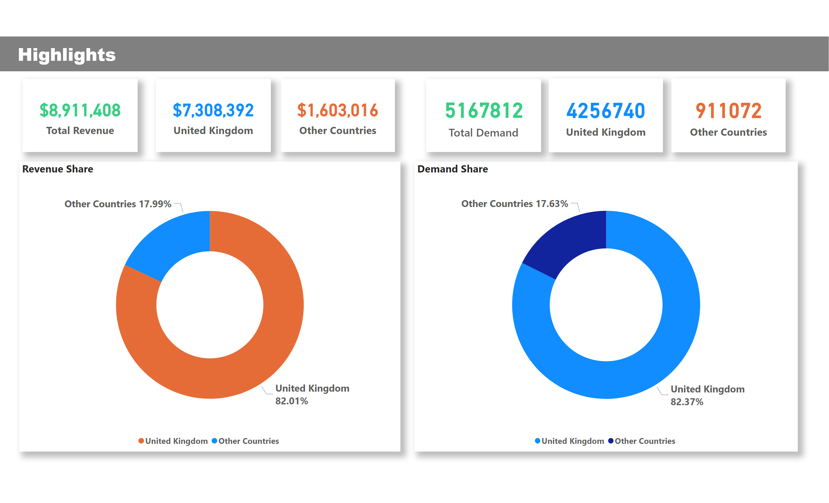

Slide 10
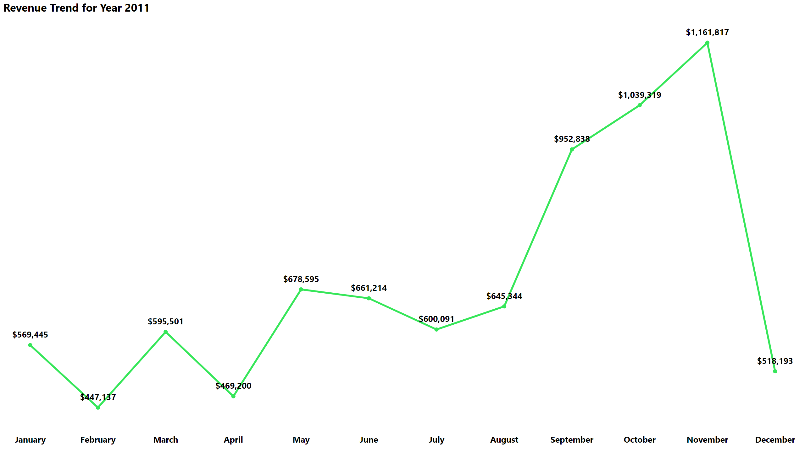

Slide 11
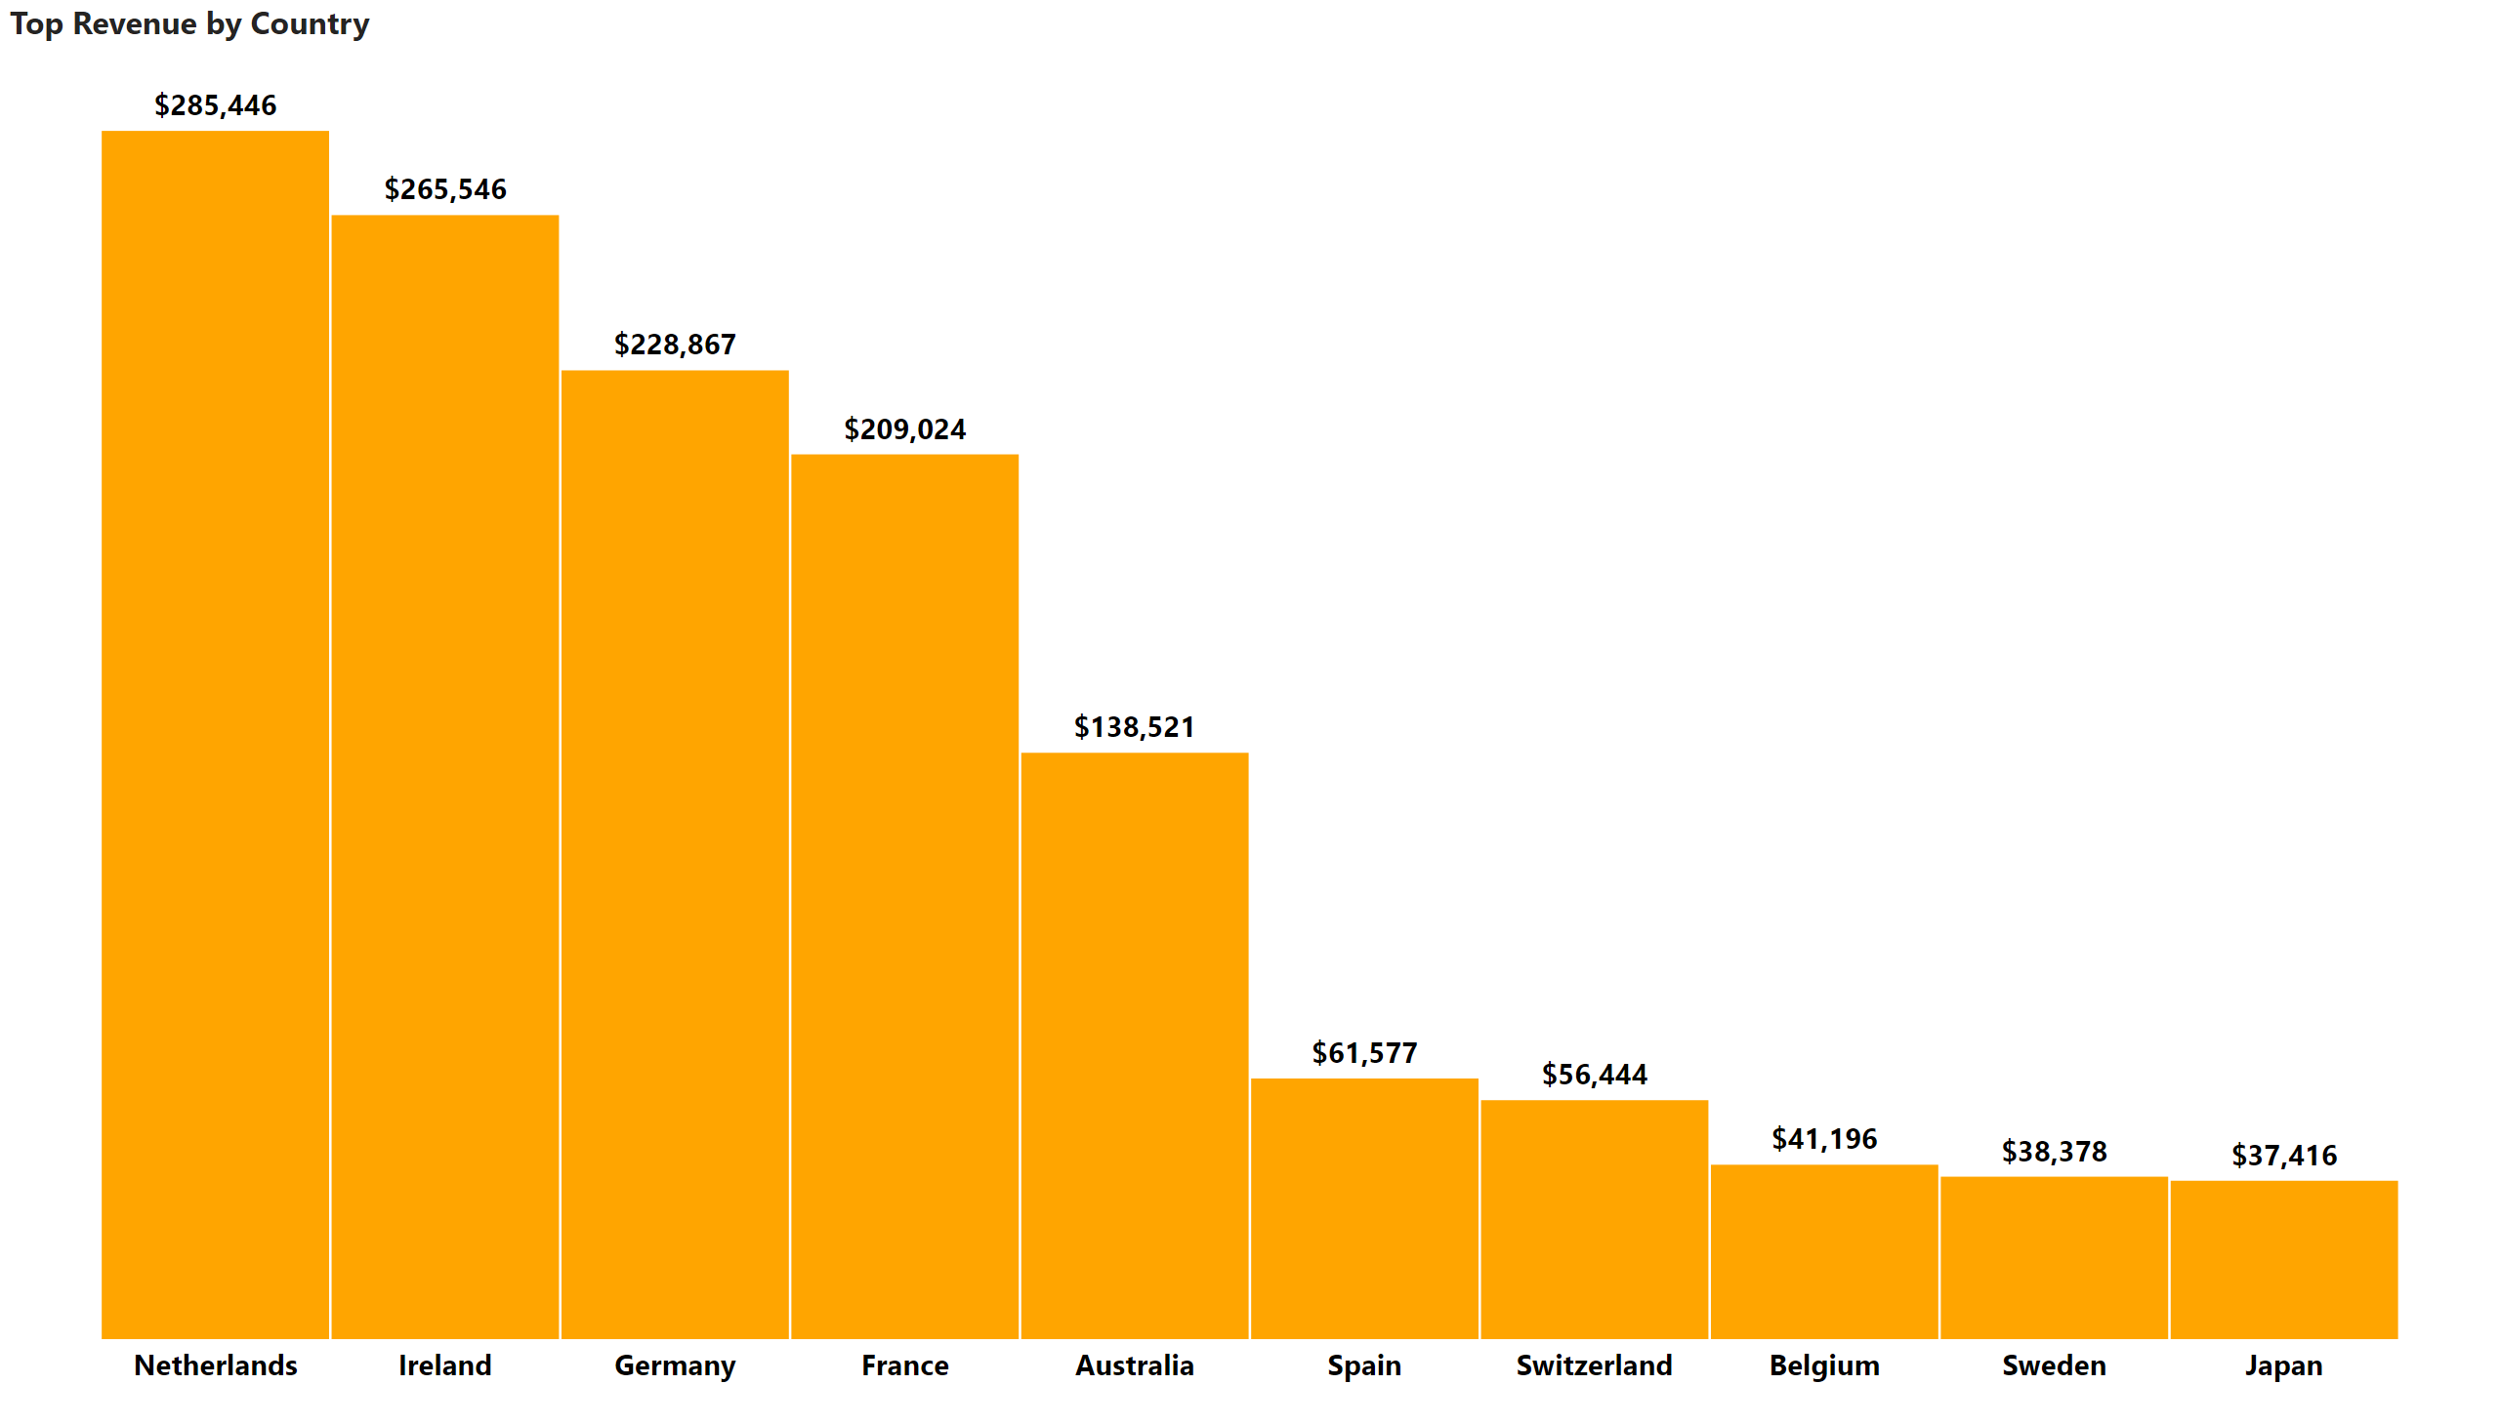

Slide 12
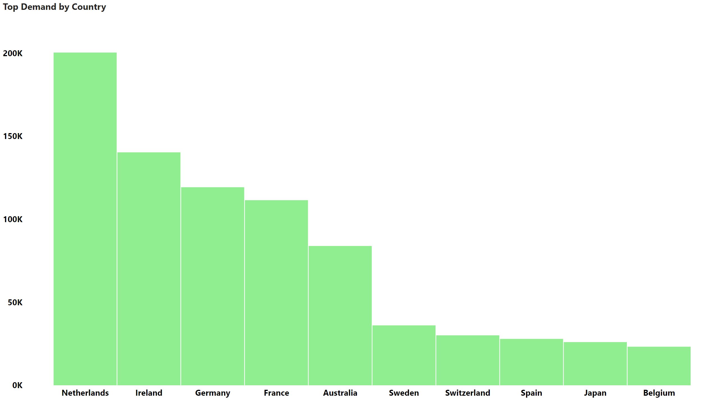

Slide 13
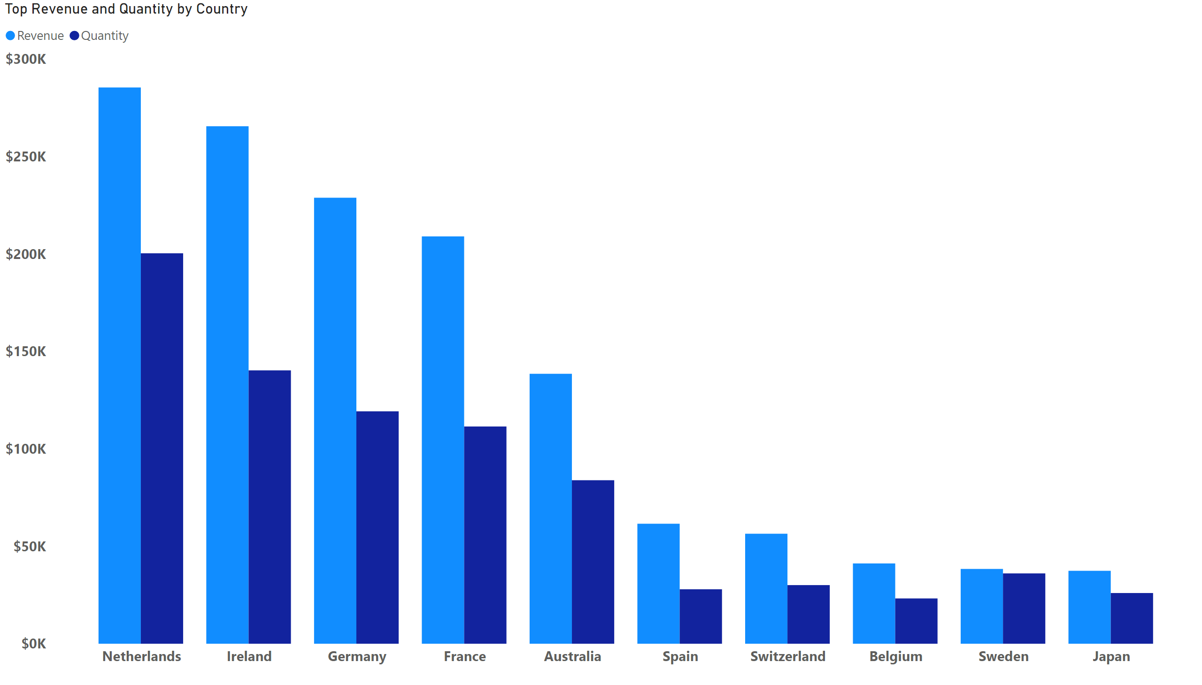

Slide 14
